Slide 1
Machine Learning

Slide 2
A Regression Example
sklearn.datasets.fetch_california_housing — scikit-learn 1.2.2 documentation

Slide 3
Common Methods
housing =pd.read_csv(
housing.info()
The info() method is useful to get a quick description of the data, in particular the total number of rows, and each attribute’s type and number of non-null values

Slide 4
Common Methods
all attributes are float64 (numeric) except ocean_proximity is object (text)
housing["ocean_proximity"].value_counts()
housing["ocean_proximity"].value_counts().plot(kind='barh’)
The describe() method shows a summary of the numerical attributes
Another quick way to get a feel of the type of data you are dealing with is to plot a histogram for each numerical attribute.

Slide 5
Visualize data to get insights
Looking for Correlations

Slide 6
Data Preparation
Feature Engineering: Creating new features (columns) out of our raw data using domain knowledge
Imputation: Inserting vaules where they might be missing to have a complete dataset
Encoding Categorical Variables: Transforming categorical variabels into some numerical variation
Scaling: Applying a scalar that transforms all of our data on the same numerical scale

Slide 7
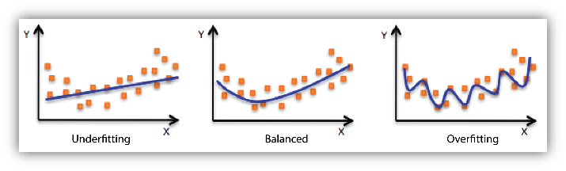

Slide 10
Regression

Slide 11
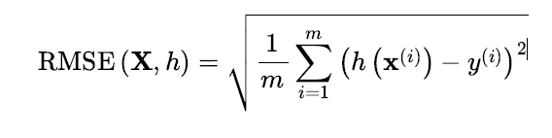
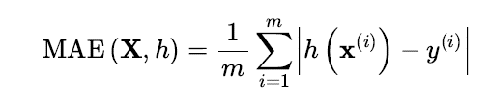
Performance Measure
RMSE is a good measure for regression tasks
If there are many outliers, use MAE

Slide 12
Classification

Slide 13
Performance Measures
Evaluating a classifier is trickier than evaluating a regressor
There are many performance measures available

Slide 14
Measuring accuracy with Cross-Validation
Using K-fold cross-validation means
splitting the training set into K folds
then training the model K times, holding out a different fold each time for evaluation
from sklearn.model_selection import cross_val_score
Even with a dummy classifier, you can get 90% accuracy is your dataset contains the 10% of the label its classifying
For skewed datasets accuracy is generally not the preferred performance metric
A better way to measure performance is Confusion matrix

Slide 15
Confusion Matrix
The general idea of a confusion matrix is to count the number of times instances of class A are classified as class B, for all A/B pairs.
For example, to know the number of times the classifier confused images of 8s with 0s, you would look at row #8, column #0 of the confusion matrix.
from sklearn.metrics import confusion_matrix
([
[53892, 687],
[ 1891, 3530]])

Slide 17
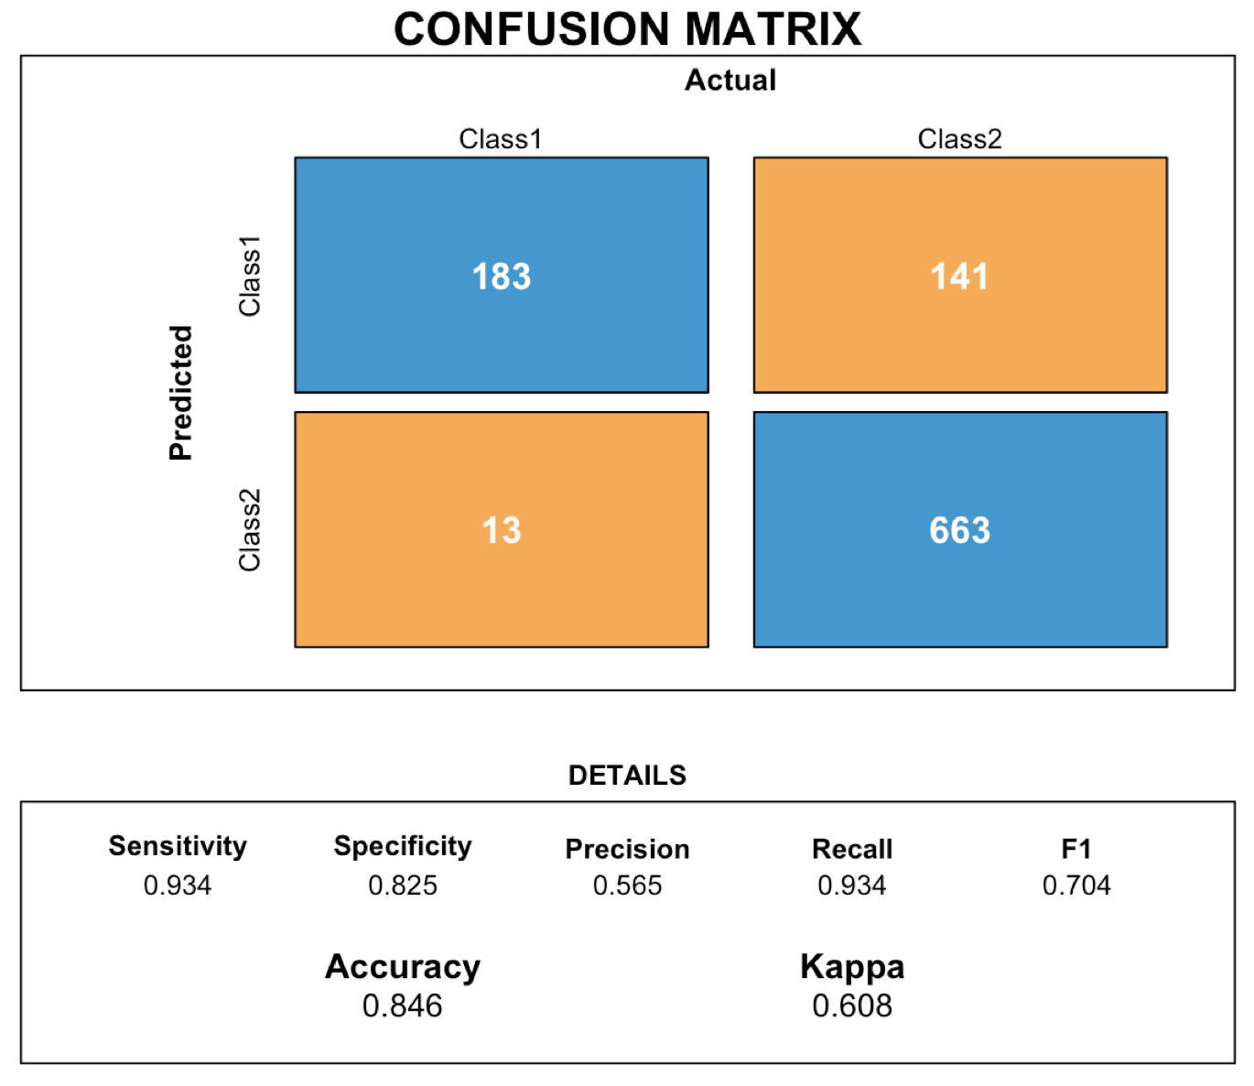

Slide 18
Precision and recall
Precision is a measure of the accuracy of positive predictions. Precision = TP / (TP + FP)
Recall is a measure of the completeness of positive predictions.Recall = TP / (TP + FN)
A high-precision classifier will have a low number of false positives, while a high-recall classifier will have a low number of false negatives.
The ideal classifier will have both high precision and high recall.
In the context of spam filtering, precision is a measure of how many emails the filter correctly identifies as spam, while recall is a measure of how many spam emails the filter correctly identifies.
The F score is the harmonic mean of precision and recall
F1 = 2 / ( 1/ precision + 1/recall)
The F score favors classifiers that have similar precision and recall

Slide 19
Precision Recall Trade off
The SGDClassifier makes classification decisions by computing a score for each instance.
If the score is greater than a threshold, the instance is assigned to the positive class. Otherwise, it is assigned to the negative class.
The precision and recall of a classifier can be affected by the threshold used to make classification decisions.
A higher threshold will increase precision and decrease recall.
A lower threshold will increase recall and decrease precision.

Slide 21
How to decide which Threshold to use

Slide 22
Multiclass Classification
Can distinguish between more than two classes.
Also called multinomial classifiers
Some Scikit-Learn classifiers, such as LogisticRegression, RandomForestClassifier, and GaussianNB, are capable of handling multiple classes natively.
Others, such as SGDClassifier or SVC, are strictly binary classifiers
However you can use multiple binary classifiers for multiclass classification.

Slide 23
One vs Rest / One vs One
One way to create a system that can classify the digit images into 10 classes (from 0 to 9) is to train 10 binary classifiers, one for each digit (a 0-detector, a 1-detector, a 2-detector, and so on)
If there are N classes, you need to train N × (N – 1) / 2 classifiers. For the MNIST problem, this means training 45 binary classifiers!
SVM scales poorly as the training size grows, so One vs One is preferred
For most binary classification algorithms, OvR is preferred
Scikit-Learn detects when you try to use a binary classification algorithm for a multiclass classification task, and it automatically runs OvR or OvO, depending on the algorithm

Slide 24
Error Analysis
First look at the confusion matrix. But there are N classes instead of 2
Analyzing individual errors can also be a good way to gain insights on what your classifier is doing and why it is failing

Slide 25
Multilabel Classification
You may want your classifier to output multiple classes for each instance.
Consider a face-recognition classifier: what should it do if it recognizes several people in the same picture?

Slide 26
Ensemble Learning
combine the predictions of several base estimators built with a given learning algorithm in order to improve generalizability / robustness over a single estimator.
Two types Averaging / Boosting methods

Slide 27
Average / Boosting methods

Slide 28
Averaging Methods
In averaging methods, the driving principle is to build several estimators independently and then to average their predictions. On average, the combined estimator is usually better than any of the single base estimator because its variance is reduced.

Slide 29
Voting Classifier

Slide 30
Voting Classifier

Slide 31
Voting Classifier
This voting classifier often achieves a higher accuracy than the best classifier in the ensemble.
In fact, even if each classifier is a weak learner (meaning it does only slightly better than random guessing), the ensemble can still be a strong learner (achieving high accuracy), provided there are a sufficient number of weak learners and they are sufficiently diverse

Slide 32
Bagging / Pasting
One way to get diverse classifiers is to use very different training algorithms, as just discussed.
Another approach is to use the same training algorithm for every predictor but train them on different random subsets of the training set.
When sampling is performed with replacement, this method is called bagging (short for bootstrap aggregating ). When sampling is performed without replacement, it is called pasting.

Slide 33
Bagging Classifier
bag_clf = BaggingClassifier(DecisionTreeClassifier(), n_estimators=500, max_samples=100, random_state=42)
The code trains an ensemble of 500 Decision Tree classifiers: each is trained on 100 training instances randomly sampled from the training set with replacement (this is an example of bagging, but if you want to use pasting instead, just set bootstrap=False). The n_jobs parameter tells Scikit-Learn the number of CPU cores to use for training and predictions, and –1 tells Scikit-Learn to use all available cores.

Slide 35
Comparison
ensemble’s predictions will likely generalize much better than the single Decision Tree’s predictions
the ensemble has a comparable bias but a smaller variance (it makes roughly the same number of errors on the training set, but the decision boundary is less irregular).

Slide 36
Out Of Bag Evaluation

Slide 37
Boosting
Boosting (originally called hypothesis boosting) refers to any Ensemble method that can combine several weak learners into a strong learner. The general idea of most boosting methods is to train predictors sequentially, each trying to correct its predecessor.

Slide 38
AdaBoost
AdaBoost stands for Adaptive Boosting.
It is a boosting algorithm that can be used for both classification and regression tasks.
AdaBoost works by iteratively training a series of weak learners and then combining them to form a strong learner.
The weak learners are trained on weighted versions of the training data, with the weights being adjusted to focus on the misclassified instances.
The strong learner is then trained on the predictions of the weak learners, with the weights of the weak learners being used to determine how much influence each learner has on the final prediction.
AdaBoost is a powerful algorithm that can be used to improve the performance of a wide variety of machine learning models.

Slide 39
Stacking Classifier

